Slide 1
Chapter Three
Part One: Decisions, Relational Operators

Slide 2
Chapter Goals
To implement decisions using the if statement
To compare integers, floating-point numbers, and Strings
To write statements using the Boolean data type
To develop strategies for testing your programs
To validate user input
In this chapter, you will learn how to program simple and complex decisions. You will apply what you learn to the task of checking user input.

Slide 3
Contents
The if Statement
Relational Operators
Nested Branches
Multiple Alternatives
Problem Solving: Flowcharts
Problem Solving: Test Cases
Boolean Variables and Operators
Analyzing Strings
Application: Input Validation

Slide 4
The if Statement
A computer program often needs to make decisions based on input, or circumstances
For example, buildings often ‘skip’ the 13th floor, and elevators should too
The 14th floor is really the 13th floor
So every floor above 12 is really ‘floor - 1’
If floor > 12, Actual floor = floor - 1
The two keywords of the if statement are:
if
else
The if statement allows a program to carry out different actions depending on the nature of the data to be processed.

Slide 5
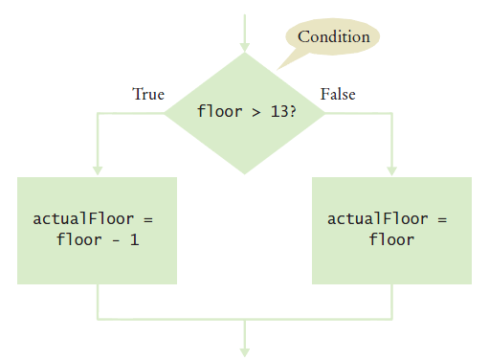
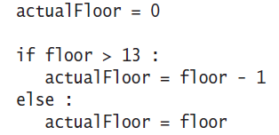
Flowchart of the if Statement
One of the two branches is executed once
True (if) branch or False (else) branch

Slide 6
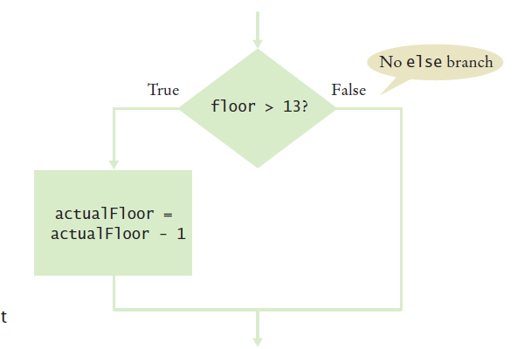
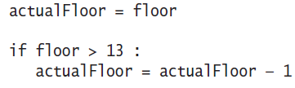
Flowchart with only a True Branch
An if statement may not need a ‘False’ (else) branch
Notes:
The else statement is not needed in the case, since it just actual floor = to the floor.
This is essentially a no op

Slide 7
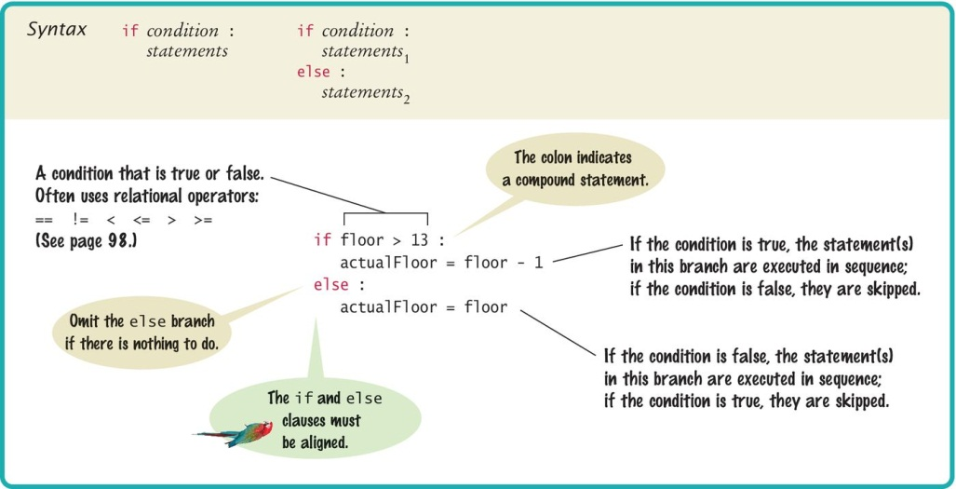
Syntax 3.1: The if Statement

Slide 8
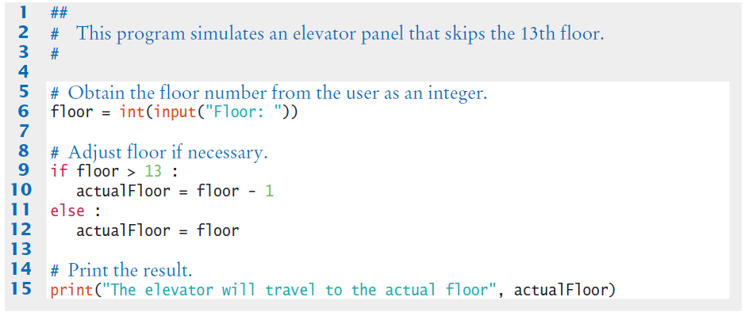
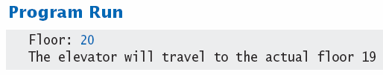
Elevatorsim.py

Slide 9
Our First Example
Open the file:
elevatorsim.py
This is a slightly modified program
Run the program
Try a value that is less that 13
What is the result?
Run the program again with a value that is greater than 13
What is the result?
What happens if you enter 13?

Slide 10
Our First Example (2)
Revised Problem Statement (1):
Check the input entered by the user:
If the input is 13, set the value to 14 and print a message
Modify the elevatorsim program to test the input
The relational operator for equal is “==“
Modified Problem Statement (2)
In some countries the number 14 is considered unlucky.
What is the revised algorithm?
Modify the elevatorsim program to “skip” both the 13th and 14th floor
Notes:
If floor is greater equal to 13 or 14
set floor to floor minus two

Slide 11
Compound Statements
Some constructs in Python are compound statements.
compound statements span multiple lines and consist of a header and a statement block
The if statement is an example of a compound statement
Compound statements require a colon “:” at the end of the header.
The statement block is a group of one or more statements, all indented to the same column
The statement block starts on the line after the header and ends at the first statement indented less than the first statement in the block
If you use Wing; Wing properly indents the statement block.
at the end of the block enter a blank line and wing will shift back to the first column in the current block

Slide 12
Compound Statements
Statement blocks can be nested inside other types of blocks (we will learn about more blocks later)
Statement blocks signal that one or more statements are part of a given compound statement
In the case of the if construct the statement block specifies:
The instructions that are executed if the condition is true
Or skipped if the condition is false
Statement blocks are visual cues that allow you to follow the login and flow of a program

Slide 13
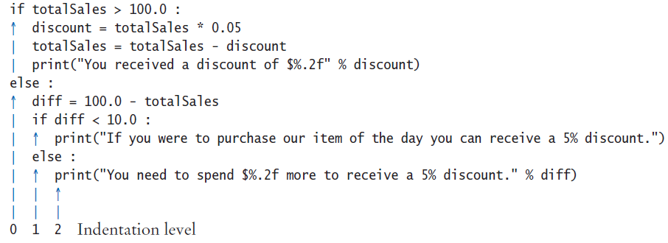
Tips on Indenting Blocks
Let Wing do the indenting for you…
This is referred to as “block structured” code. Indenting consistently is not only syntactically required in Python, it also makes code much easier to follow.

Slide 14
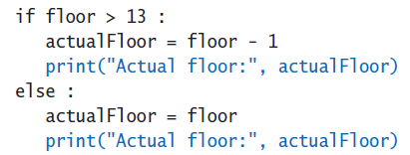
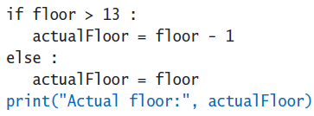
A Common Error
Avoid duplication in branches
If the same code is duplicated in each branch then move it out of the if statement.

Slide 15
The Conditional Operator
A “shortcut” you may find in existing code
It is not used in this book
The shortcut notation can be used anywhere that a value is expected
True branch
Condition
False branch
Complexity is BAD….
This “shortcut” is difficult to read and a poor programming practice

Slide 16
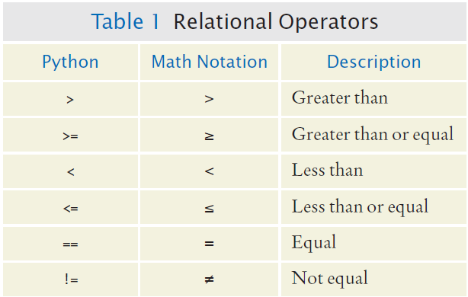
Relational Operators
Every if statement has a condition
Usually compares two values with an operator
if floor > 13 :
..
if floor >= 13 : ..
if floor < 13 : ..
if floor <= 13 :
..
if floor == 13 : ..

Slide 17
Assignment vs. Equality Testing
Assignment: makes something true.
floor = 13
Equality testing: checks if something is true.
if floor == 13 :

Slide 18
Comparing Strings
Checking if two strings are equal
if name1 == name2 :
print("The strings are identical")
Checking if two strings are not equal
if name1 != name2 :
print("The strings are not identical")

Slide 19
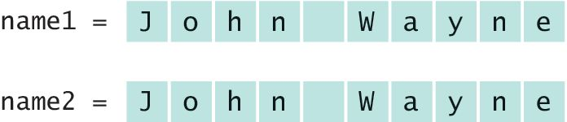
Checking for String Equality (1)
For two strings to be equal, they must be of the same length and contain the same sequence of characters:

Slide 20
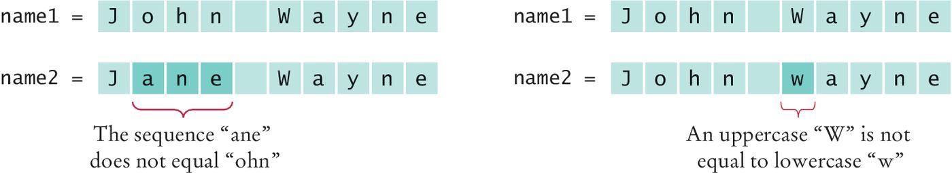
Checking for String Equality (2)
If any character is different, the two strings will not be equal:

Slide 21
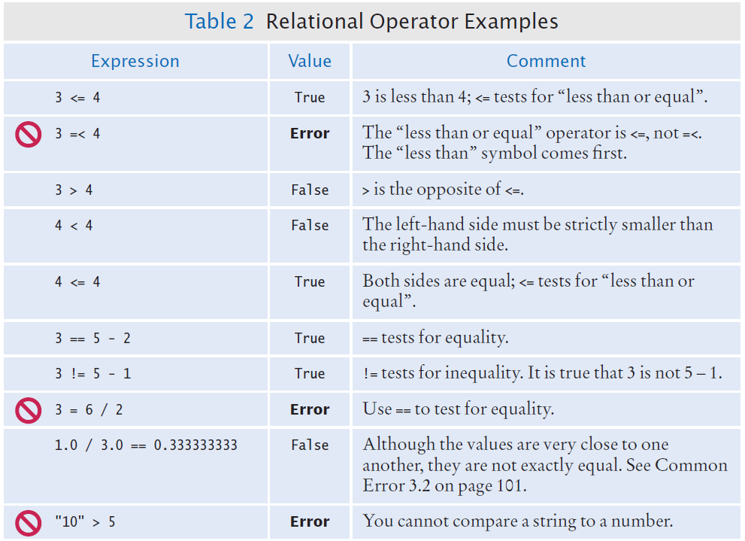
Relational Operator Examples (1)

Slide 22
Relational Operator Examples (2)

Slide 23
Another Example
Open the file:
compare.py
Run the program
What are the results?

Slide 24
Common Error (Floating Point)
Floating-point numbers have only a limited precision, and calculations can introduce roundoff errors.
You must take these inevitable roundoffs into account when comparing floating point numbers.

Slide 25
Common Error (Floating Point, 2)
For example, the following code multiplies the square root of 2 by itself.
Ideally, we expect to get the answer 2:
r = math.sqrt(2.0)
if r * r == 2.0 :
print("sqrt(2.0) squared is 2.0")
else :
print("sqrt(2.0) squared is not 2.0 but", r * r)
Output:
sqrt(2.0) squared is not 2.0 but 2.0000000000000004

Slide 26

The Use of EPSILON
Use a very small value to compare the difference to determine if floating-point values are ‘close enough’
The magnitude of their difference should be less than some threshold
Mathematically, we would write that x and y are close enough if:
EPSILON = 1E-14
r = math.sqrt(2.0)
if abs(r * r - 2.0) < EPSILON :
print("sqrt(2.0) squared is approximately 2.0")

Slide 27
Lexicographical Order
To compare Strings in ‘dictionary’ like order:
string1 < string2
Notes
All UPPERCASE letters come before lowercase
‘space’ comes before all other printable characters
Digits (0-9) come before all letters
See Appendix A for the Basic Latin (ASCII) Subset of Unicode

Slide 28
Operator Precedence
The comparison operators have lower precedence than arithmetic operators
Calculations are done before the comparison
Normally your calculations are on the ‘right side’ of the comparison or assignment operator
Calculations
actualFloor = floor + 1
if floor > height + 1 :

Slide 29


Implementing an if Statement (1)
1) Decide on a branching condition
2) Write pseudocode for the true branch
3) Write pseudocode for the false branch

Slide 30


Implementing an if Statement (2)
4) Double-check relational operators
Test values below, at, and above the comparison (127, 128, 129)
5) Remove duplication
6) Test both branches

Slide 31
Implementing an if Statement (3)
7. Write the code in Python

Slide 32
A Third Example
The university bookstore has a Kilobyte Day sale every October 24 (10.24), giving an 8 percent discount on all computer accessory purchases if the price is less than $128, and a 16 percent discount if the price is at least $128.
if originalPrice < 128 :
discountRate = 0.92
else :
discountRate = 0.84
discountedPrice = discountRate * originalPrice

Slide 33
The Sale Example
Open the file:
sale.py
Run the program several time using different values
Use values less than 128
Use values greater that 128
Enter 128
What results do you get?

Slide 34
Nested Branches
You can nest an if inside either branch of an if statement.
Simple example: Ordering drinks
Ask the customer for their drink order
if customer orders wine
Ask customer for ID
if customer’s age is 21 or over
Serve wine
Else
Politely explain the law to the customer
Else
Serve customers a non-alcoholic drink

Slide 35
Flowchart of a Nested if
Ask for order
Nested if-else inside true branch of an if statement.
Three paths
Wine?
True
Check ID
False
>= 21?
True
Serve wine
Serve non-alcoholic drink
False
Read law
Done

Slide 36
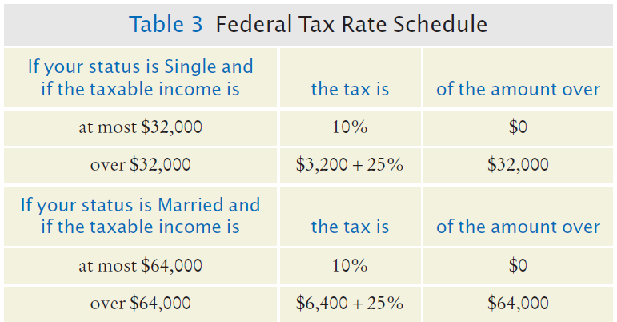
Tax Example: nested ifs
Four outcomes (branches)
Single
<= 32000
> 32000
Married
<= 64000
> 64000

Slide 37
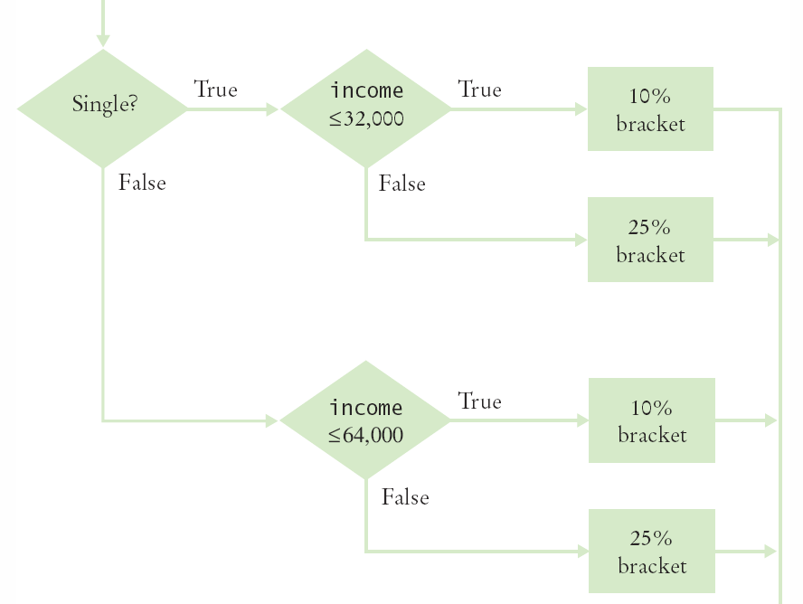
Flowchart for the Tax Example
Four branches

Slide 38
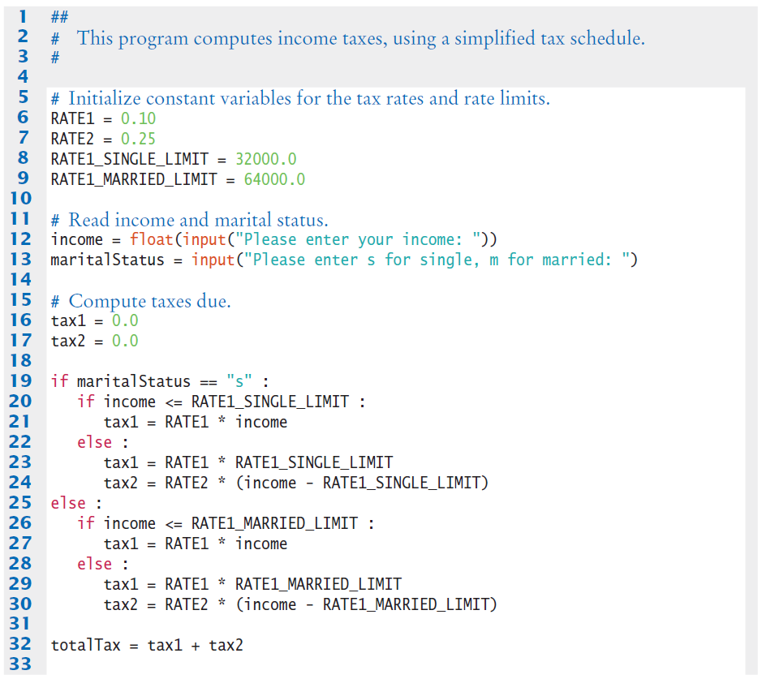
Taxes.py (1)

Slide 39
Taxes.py (2)
The ‘True’ branch (Single)
Two branches within this branch

Slide 40
Taxes.py (3)
The ‘False’ branch (Married)

Slide 41
Running the Tax Example
Open the file:
taxes.py
Run the program several time using different values for income and marital status
Use income values less than $32,000
Use income values greater than $64,000
Enter “&” as the marital status
What results do you get?

Slide 42
Hand-tracing
Hand-tracing helps you understand whether a program works correctly
Create a table of key variables
Use pencil and paper to track their values
Works with pseudocode or code
Track location with a marker
Use example input values that:
You know what the correct outcome should be
Will test each branch of your code

Slide 43
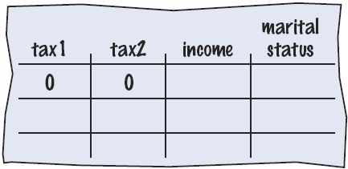
Hand-tracing the Tax Example
Setup
Table of variables
Initial values

Slide 44
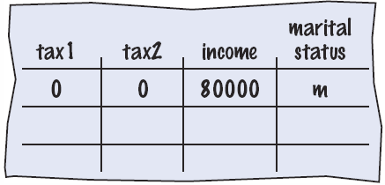
Hand-tracing the Tax Example (2)
Input variables
From user
Update table
Because marital status is not “s” we skip to the else on line 25

Slide 45
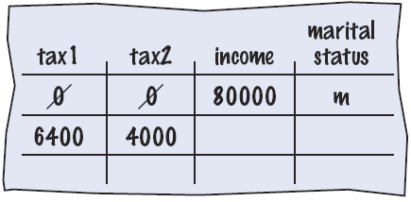
Hand-tracing the Tax Example (3)
Because income is not <= 64000, we move to the else clause on line 28
Update variables on lines 29 and 30
Use constants

Slide 46
Incremental Code and Test
Using the flag problem statement as an example:
Compute the data for the first panel
Print out the data
Color
The X and Y coordinates of the top left corner of the panel
The width of the panel
The height of the panel
Check the data
If the data is correct:
Draw the panel
Else
Look at your equations
Find and fix any errors
Check the data again
Do the next panel

Slide 47
Multiple Alternatives

Slide 48
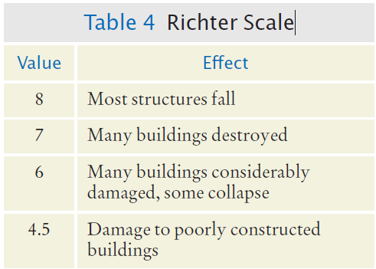
3.4 Multiple Alternatives
What if you have more than two branches?
Count the branches for the following earthquake effect example:
8 (or greater)
7 to 7.99
6 to 6.99
4.5 to 5.99
Less than 4.5
When using multiple if statements, test the general conditions after the more specific conditions.

Slide 49
Flowchart of Multiway Branching
True
>= 8.0?
Most Structures Fall
False
>= 7.0?
True
Many Buildings Destroyed
False
>= 6.0?
True
Many buildings considerably damaged, some collapse
False
>= 4.5?
True
Damage to poorly constructed buildings
False
No destruction of buildings

Slide 50
elif Statement
Short for Else, if…
As soon as one on the test conditions succeeds, the statement block is executed
No other tests are attempted
If none of the test conditions succeed the final else clause is executed

Slide 51
if, elif Multiway Branching
if richter >= 8.0 : # Handle the ‘special case’ first
print("Most structures fall")
elif richter >= 7.0 :
print("Many buildings destroyed")
elif richter >= 6.0 :
print("Many buildings damaged, some collapse")
elif richter >= 4.5 :
print("Damage to poorly constructed buildings")
else : # so that the ‘general case’ can be handled last
print("No destruction of buildings")

Slide 52
What is Wrong With This Code?
if richter >= 8.0 :
print("Most structures fall")
if richter >= 7.0 :
print("Many buildings destroyed")
if richter >= 6.0 :
print("Many buildings damaged, some collapse")
if richter >= 4.5 :
print("Damage to poorly constructed buildings")

Slide 53
earthquake Example
Open the file:
earthquake.py
Run the program with several different inputs

Slide 54
Using Flowcharts to Develop and Refine Algorithms

Slide 55
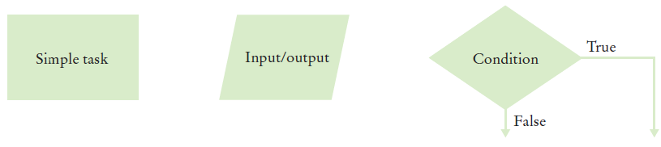
3.5 Problem Solving: Flowcharts
You have seen a few basic flowcharts
A flowchart shows the structure of decisions and tasks to solve a problem
Basic flowchart elements:
Connect them with arrows
But never point an arrow inside another branch!
Each branch of a decision can contain tasks and further decisions

Slide 56
Using Flowcharts
Flowcharts are an excellent tool
They can help you visualize the flow of your algorithm
Building the flowchart
Link your tasks and input / output boxes in the sequence they need to be executed
When you need to make a decision use the diamond (a conditional statement) with two outcomes
Never point an arrow inside another branch

Slide 57
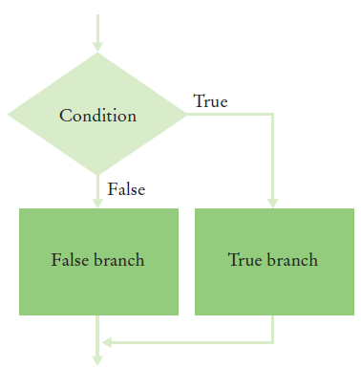
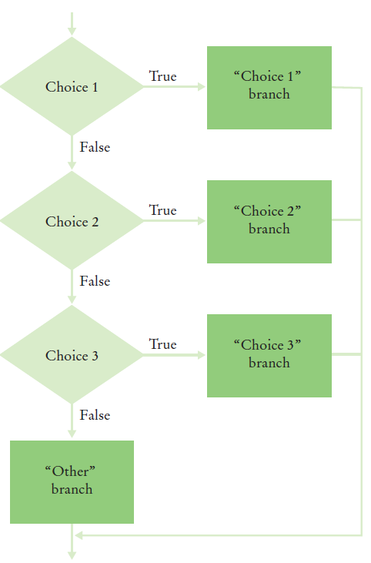
Conditional Flowcharts
Two Outcomes
Multiple Outcomes

Slide 58
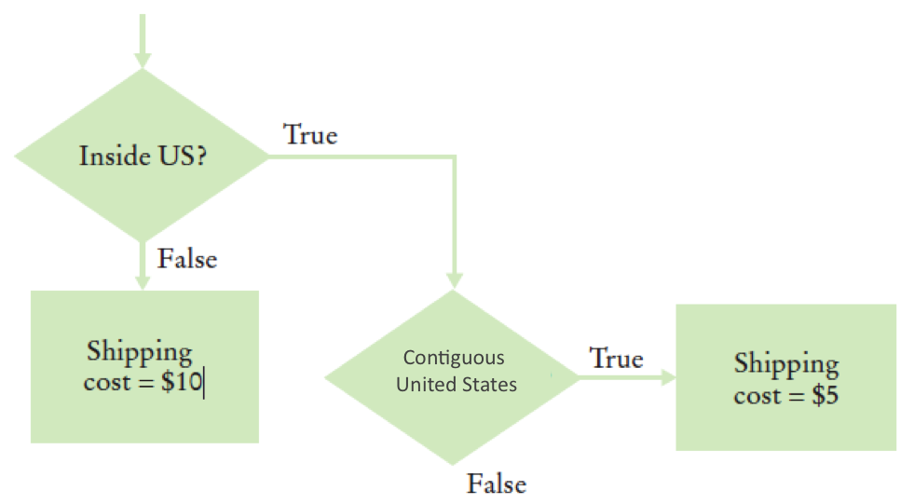
Shipping Cost flowchart
Shipping costs are $5 inside the contiguous the United States (Lower 48 states), and $10 to Hawaii and Alaska. International shipping costs are also $10.
Three Branches:
International
Branch
Hawaii/Alaska
Branch
Lower 48
Branch

Slide 59
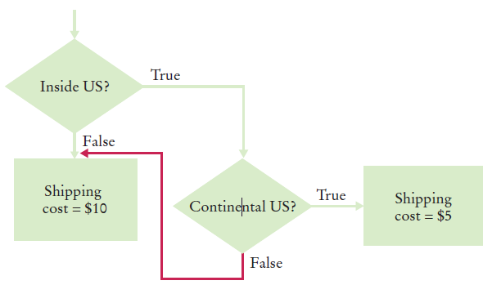
Don’t Connect Branches!
Shipping costs are $5 inside the United States, except that to Hawaii and Alaska they are $10. International shipping costs are also $10.
Don’t do this!
International
Branch
Hawaii/Alaska
Branch
Lower 48
Branch

Slide 60
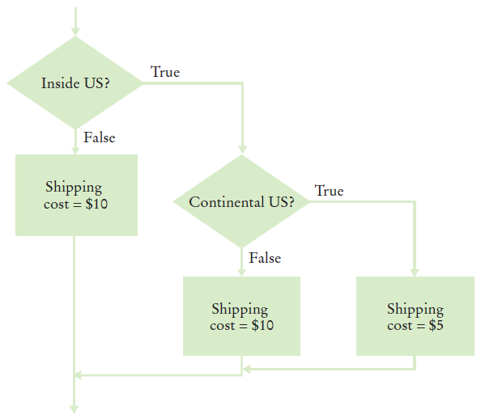
Shipping Cost Flowchart
Shipping costs are $5 inside the United States, except that to Hawaii and Alaska they are $10. International shipping costs are also $10.

Slide 61
Shipping Example
Open the file:
Shipping.py
Run the program with several different inputs?
What happens if you enter “usa” as the country?
We will learn several ways to correct the code later in this chapter

Slide 62
Complex Decision Making is Hard
Computer systems are used to help sort and route luggage at airports
The systems:
Scan the baggage tags
Sorts the items
Routes the items to conveyor belts
Humans then place the bags on trucks
In 1993 Denver built a new airport with a “state of the art” luggage system that replaced the human operators with robotic carts
The system failed
The airport could not open with out a luggage system
The system was replaced (it took over a year)
The cost was almost $1B…. (yes one billion… 1994 dollars)
The company that designed the system went bankrupt

Slide 63
Building Test Cases

Slide 64
Problem Solving: Test Cases
Aim for complete coverage of all decision points:
There are two possibilities for the marital status and two tax brackets for each status, yielding four test cases
Test a handful of boundary conditions, such as an income that is at the boundary between two tax brackets, and a zero income
If you are responsible for error checking (which is discussed in Section 3.9), also test an invalid input, such as a negative income
Each branch of your code should be covered with a test case

Slide 65
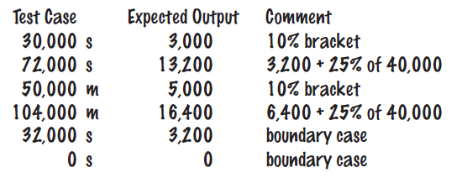
Choosing Test Cases
Choose input values that:
Test boundary cases and 0 values
Test each branch

Slide 66
Make a Schedule…
Make a reasonable estimate of the time it will take you to:
Design the algorithm
Develop test cases
Translate the algorithm to code and enter the code
Test and debug your program
Leave some extra time for unanticipated problems
As you gain more experience your estimates will become more accurate. It is better to have some extra time than to be late

Slide 67
Boolean Variables and Operators

Slide 68
Boolean Variables
Boolean Variables
A Boolean variable is often called a flag because it can be either up (true) or down (false)
boolean is a Python data type
failed = True
Boolean variables can be either True or False
There are two Boolean Operators: and, or
They are used to combine multiple conditions

Slide 69
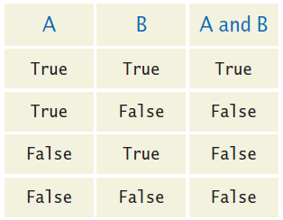
Combined Conditions: and
Combining two conditions is often used in range checking
Is a value between two other values?
Both sides of the and must be true for the result to be true
if temp > 0 and temp < 100 :
print("Liquid")

Slide 70
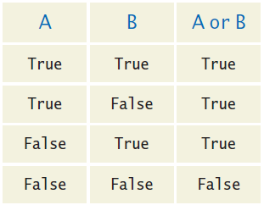
Combined Conditions: or
We use or if only one of two conditions need to be true
Use a compound conditional with an or:
If either condition is true
The result is true
if temp <= 0 or temp >= 100 :
print("Not liquid")

Slide 71
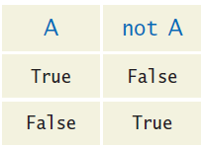
The not operator: not
If you need to invert a boolean variable or comparison, precede it with not
If you are using not, try to use simpler logic:
if not attending or grade < 60 :
print("Drop?")
if attending and not(grade < 60) :
print("Stay")
if attending and grade >= 60 :
print("Stay")

Slide 72
The not operator: inequality !
A slightly different operator is used for the not when checking for inequality rather than negation.
Example inequality:
The password that the user entered is not equal to the password on file.
if userPassword != filePassword :

Slide 73
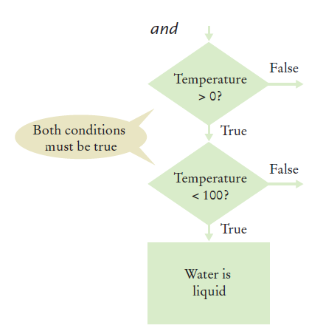
and Flowchart
This is often called ‘range checking’
Used to validate that the input is between two values
if temp > 0 and temp < 100 :
print("Liquid")

Slide 74
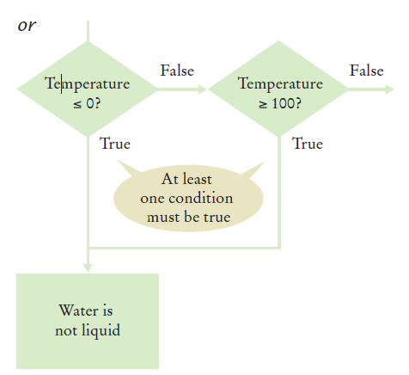
or flowchart
Another form of ‘range checking’
Checks if value is outside a range
if temp <= 0 or temp >= 100 :
print("Not Liquid")

Slide 75
Comparison Example
Open the file:
Compare2.py
Run the program with several inputs

Slide 76
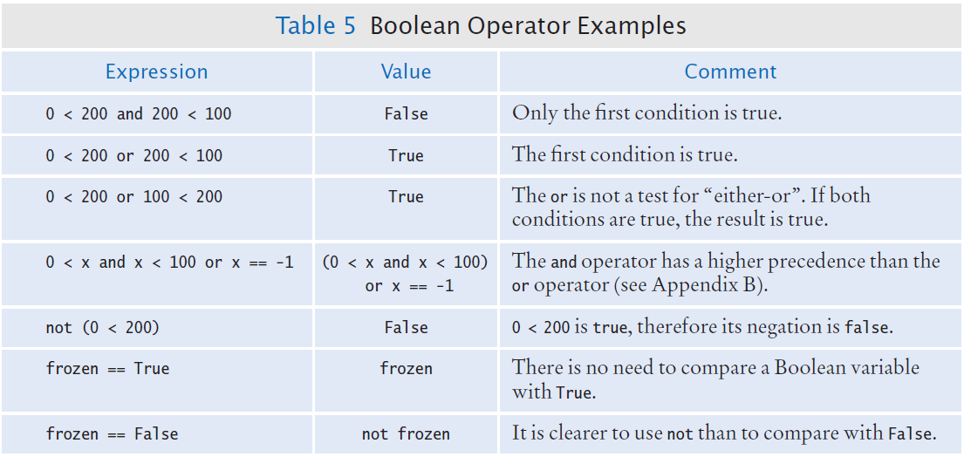
Boolean Operator Examples

Slide 77
Common Errors with Boolean Conditions
Confusing and and or Conditions
It is a surprisingly common error to confuse and and or conditions.
A value lies between 0 and 100 if it is at least 0 and at most 100.
It lies outside that range if it is less than 0 or greater than 100.
There is no golden rule; you just have to think carefully.

Slide 78
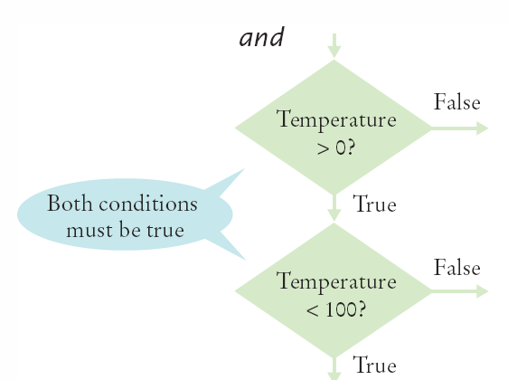
Short-circuit Evaluation: and
Combined conditions are evaluated from left to right
If the left half of an and condition is false, why look further?
if temp > 0 and temp < 100 :
print("Liquid")
Done!

Slide 79
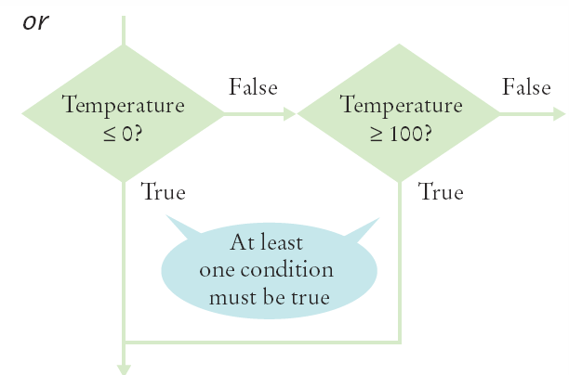
Short-circuit evaluation: or
If the left half of the or is true, why look further?
if temp <= 0 or temp >= 100 :
print("Not Liquid")
Done!

Slide 80
De Morgan’s law
De Morgan’s law tells you how to negate and and or conditions:
not(A and B) is the same as notA or notB
not(A or B) is the same as notA and notB
Example: Shipping is higher to AK and HI
To simplify conditions with negations of and or or expressions, it’s a good idea to apply De Morgan’s law to move the negations to the innermost level.
if (country != "USA"
and state != "AK"
and state != "HI") :
shippingCharge = 20.00
if not(country=="USA"
or state=="AK"
or state=="HI") : shippingCharge = 20.00

Slide 81
Analyzing Strings

Slide 82
Analyzing Strings – The in Operator
Sometimes it’s necessary to analyze or ask certain questions about a particular string.
Sometimes it is necessary to determine if a string contains a given substring. That is, one string contains an exact match of another string.
Given this code segment,
name = "John Wayne"
the expression
"Way" in name
yields True because the substring "Way" occurs within the string stored in variable name.
The not in operator is the inverse on the in operator

Slide 83
Substring: Suffixes
Suppose you are given the name of a file and need to ensure that it has the correct extension
if filename.endswith(".html") :
print("This is an HTML file.")
The endswith() string method is applied to the string stored in filename and returns True if the string ends with the substring ".html" and False otherwise.

Slide 84
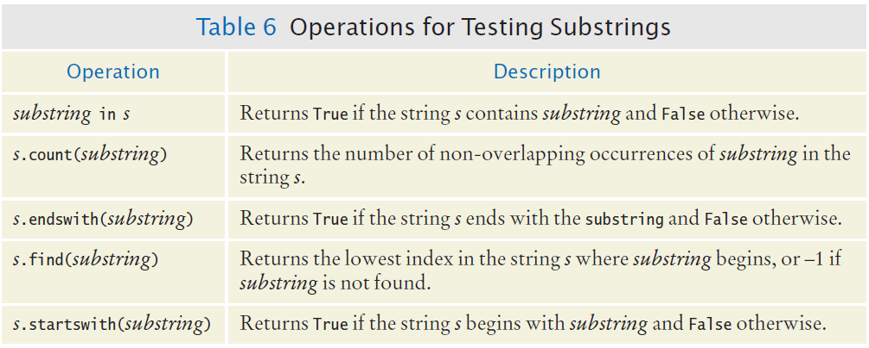
Operations for Testing Substrings

Slide 85
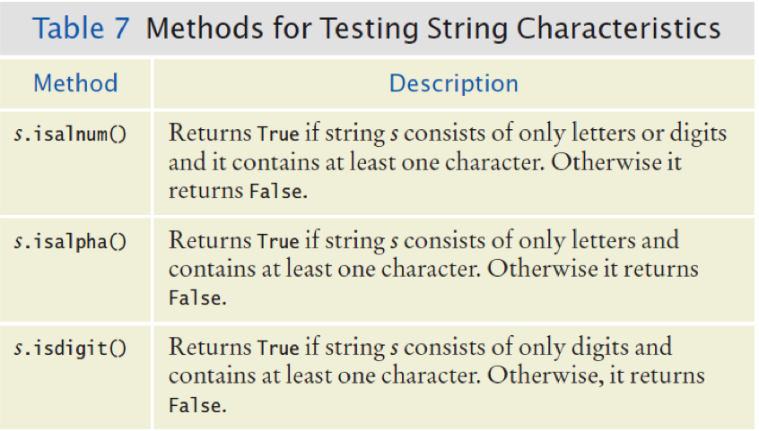
Methods: Testing String Characteristics (1)
Notes:
Is alphanumeric
Is alphabetic

Slide 86
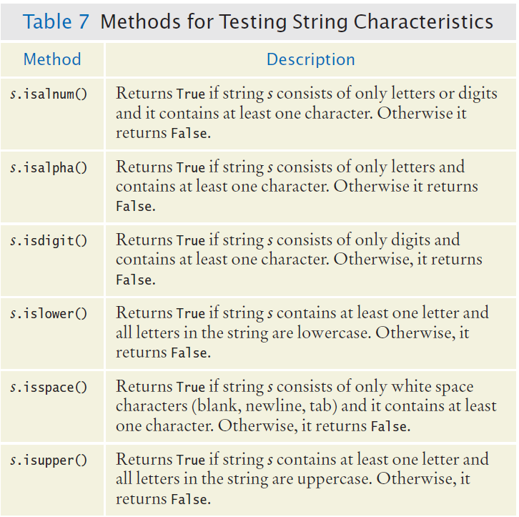
Methods for Testing String Characteristics (2)

Slide 87
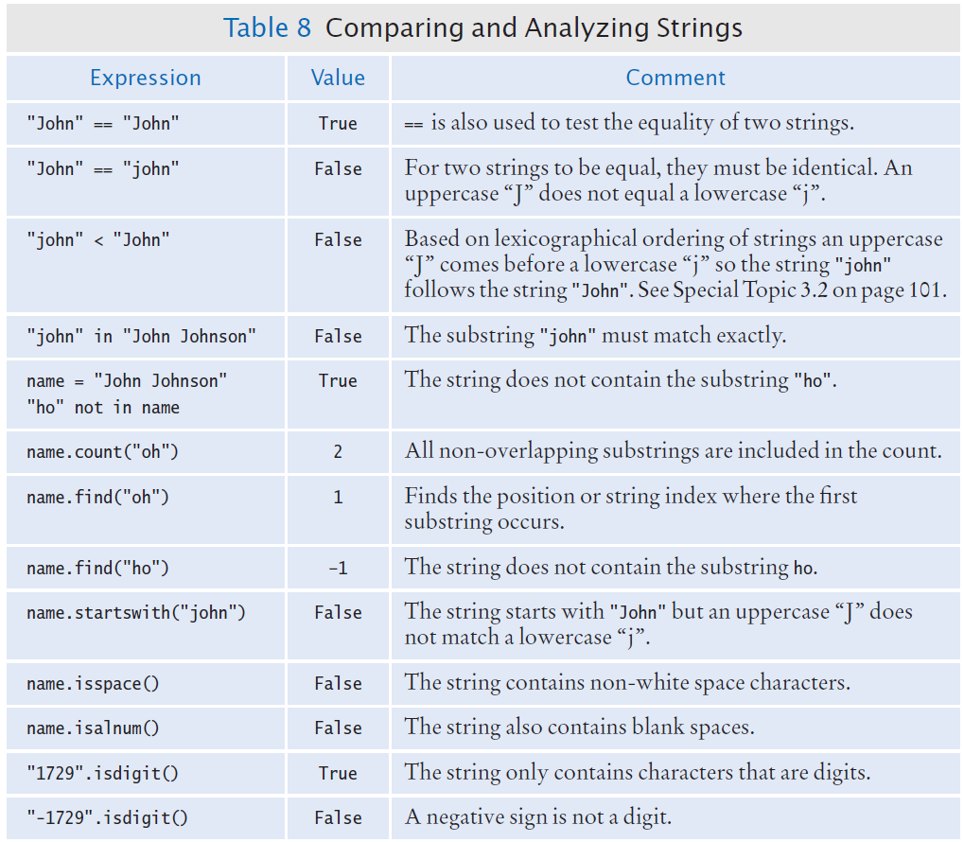
Comparing and Analyzing Strings (1)

Slide 88
Comparing and Analyzing Strings (2)

Slide 89
Substring Example
Open the file:
Substrings.ph
Run the program and test several strings and substrings

Slide 90
Input Validation

Slide 91
Input Validation
Accepting user input is dangerous
Consider the Elevator program:
Assume that the elevator panel has buttons labeled 1 through 20 (but not 13).

Slide 92
Input Validation
The following are illegal inputs:
The number 13
if floor == 13 :
print("Error: There is no thirteenth floor.")
Zero or a negative number
A number larger than 20
if floor <= 0 or floor > 20 :
print("Error: The floor must be between 1 and 20.")
An input that is not a sequence of digits, such as five:
Python’s exception mechanism is needed to help verify integer and floating point values (Chapter 7).

Slide 93
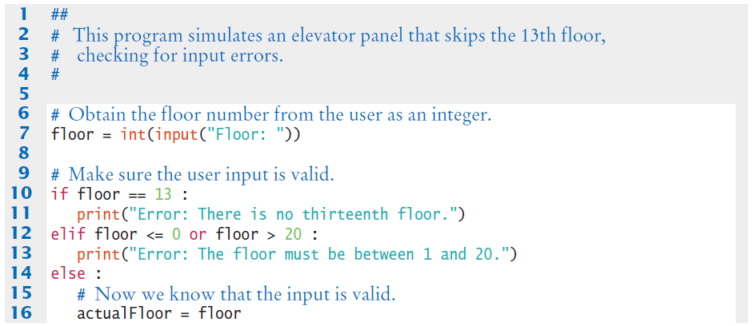
Elevatorsim2.py

Slide 94
Elevator Simulation
Open the file:
elevatorsim2.py
Test the program with a range of inputs including:
12
14
13
-1
0
23
19

Slide 95
Chapter Three Review

Slide 96
Summary: if Statement
The if statement allows a program to carry out different actions depending on the nature of the data to be processed.
Relational operators ( < <= > >= == != ) are used to compare numbers and Strings.
Strings are compared in lexicographic order.
Multiple if statements can be combined to evaluate complex decisions.
When using multiple if statements, test general conditions after more specific conditions.

Slide 97
Summary: Flowcharts and Testing
When a decision statement is contained inside the branch of another decision statement, the statements are nested.
Nested decisions are required for problems that have two levels of decision making.
Flow charts are made up of elements for tasks, input/output, and decisions.
Each branch of a decision can contain tasks and further decisions.
Never point an arrow inside another branch.
Each branch of your program should be covered by a test case.
It is a good idea to design test cases before implementing a program.

Slide 98
Summary: Boolean
The type boolean has two values, true and false.
Python has two Boolean operators that combine conditions: and and or.
To invert a condition, use the not operator.
When checking for equality use the ! operator.
The and and or operators are computed lazily:
As soon as the truth value is determined, no further conditions are evaluated.
De Morgan’s law tells you how to negate and and or conditions.

